Slide 1

Classification for Math Problems

Slide 2
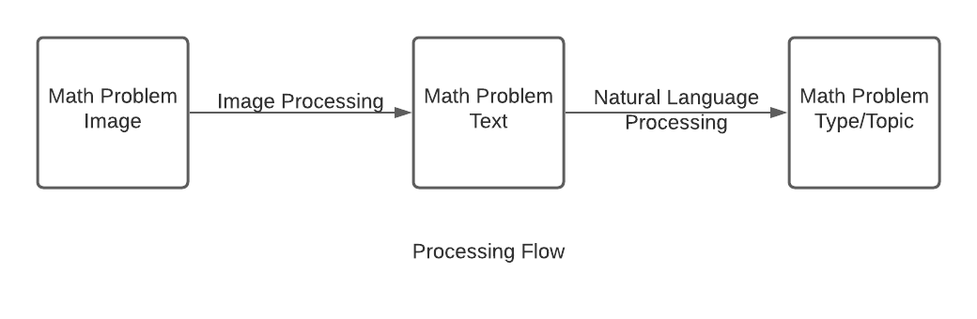
Problem Statement
We are looking to classify math problems by problem type

Slide 3




Slide 4
Use of Classification
Recommend learning resources
Future Considerations:
Provide answer check
Gamification?

Slide 5
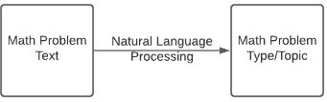
Analytic Approach
Muli-output/Multilabel classification problem
We trained a Decision Tree algorithm to perform multi-output classification of text into categories of math problems.

Slide 6
Data Processing
Sourced from GitHub community called Hugging Face
Subset of larger data set
56 categories of math problems
We took 10,000 questions from each category
56 categories of math problems
Examples: Algebra Linear 1d, Arithmetic Add or Sub, Calculus differentiate, Numbers is prime, Polynomials expand
Problems are synthetically created

Slide 7
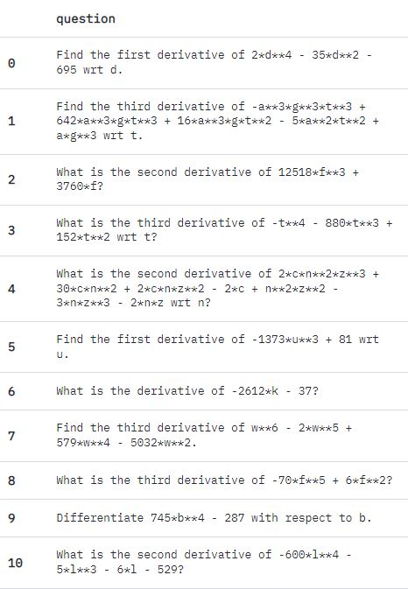
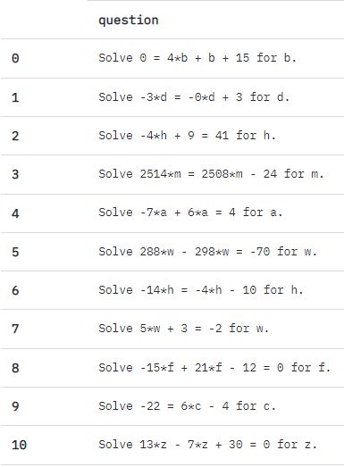
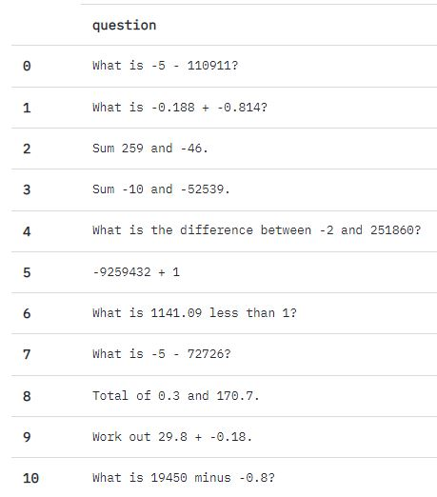
Some examples of math problems
Notes:
On this slide, have short discussion of how similar questions are to each other in each category.

Slide 8
Model Form and Fitting
Decision Tree algorithm:
LGBM Classifier (Light Gradient Boosted Machine Classifier)
Two methods:
Classifier Chain and Multi Output Classifier
Used TF-IDF measure
Determines how relevant a word is to a question and a category
Counts appearances of words in questions (Term Frequency) and across categories (Inverse Document Frequency)
Higher the TF-IDF score, the more relevant the word is
Notes:
Uses boosting, which creates Ensembles that are constructed from decision tree models. Trees are added one at a time to the ensemble and fit to correct the prediction errors made by prior models.
Models are fit using any arbitrary differentiable loss function and gradient descent optimization algorithm. This gives the technique its name, “gradient boosting,” as the loss gradient is minimized as the model is fit.

Slide 9
Model Results and Analysis
Used Three-fold Cross Validation
Calculated F-scores to measure accuracy of the fitted models
F-score for LGBM with Multi Output Classifier: .949699
F-score for LGBM with Classifier Chain: .948426
Chose LGBM with Multi Output Classifier as better model

Slide 10
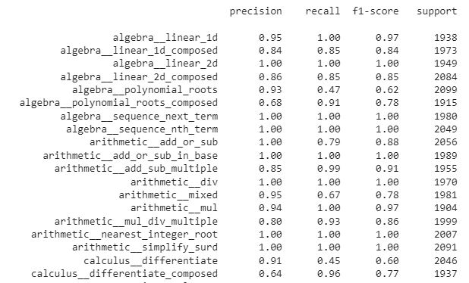
Model Results and Analysis
Classification Report:
Most Categories have 1.00 Precision, Recall, & F score
Some categories with poor scores likely due to related categories
Notes:
Precision = TP/(TP + FP)
Rate of positive cases classified as positive
Recall = TP/(TP+FN)
Fraction of positives that were correctly identified
Weighted harmonic mean
F1 Score = 2*(Recall * Precision) / (Recall + Precision)

Slide 11
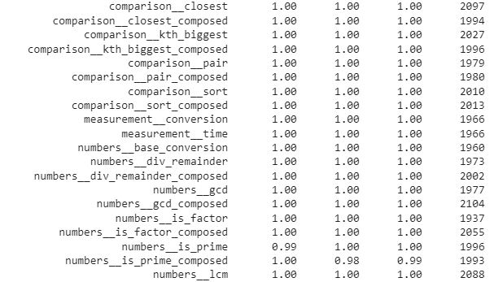
Model Results and Analysis Cont.

Slide 12
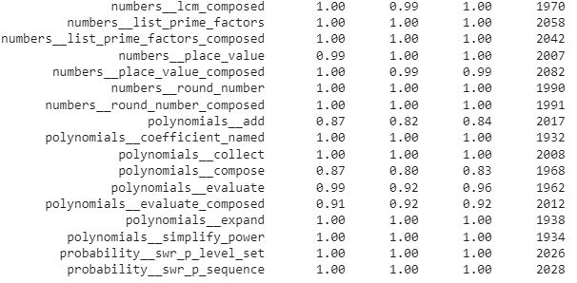
Model Results and Analysis Cont.

Slide 13
Conclusion
Using a LGBM Classifier Algorithm to classify math problem text into concept categories
The model worked well with some limitations
Could improve the model and use case of the model by making changes to the dataset
Changing the categories and how they are comprised
Adding more questions from other sources to introduce diversity of math problems

Slide 14
Citations
Hugging Face Datasets. Github: https://github.com/huggingface/datasets/tree/master/datasets
Disaster Message NLP Pipeline. Github: https://github.com/ChristopherCochet/Disaster-Message-NLP-Pipeline/blob/master/notebooks/ML%20Pipeline%20Preparation.ipynb
Text Classification in Python by Miguel Fernandez Zafra. Url: https://towardsdatascience.com/text-classification-in-python-dd95d264c802
A gentle introduction to OCR. Url: https://towardsdatascience.com/a-gentle-introduction-to-ocr-ee1469a201aa.
Text Detection CTPN by Shaohui Ruan. Github: https://github.com/eragonruan/text-detection-ctpn
Understanding Classification Report. Url: https://muthu.co/understanding-the-classification-report-in-sklearn/

